Slide 1



“PRATHAM”
(Fully Indigenous Guide and Multimedia Robot)
Mentored By:-Rajesh Singh
Head Institute Of Robotics, INDIA
Ishan Upadhayay
Mechanical structure
Akash Srivastava Electronics Hardware
Jatin Kumar Khilrani
Firmware Development
Shantmanu System evaluator

Slide 2
Proposed System
Welcome and guide various guests and visitors
It will work in Two modes
a-Autonomous Mode: In this mode the bot movement
is according to the pre-defined path and instructions.
b- User Mode: In this mode the bot movement is controlled by remote user.

Slide 3
Main features
RFID interface
video/audio HDMI display.
Respond to visitors questions
Web interface
Zigbee nodes to identify location
Fully Interactive Robot
Robotic Arm to welcome guest
API- text to speech, internet services applicable.
Path- Learning
Flexible system programmed according to the user.

Slide 4
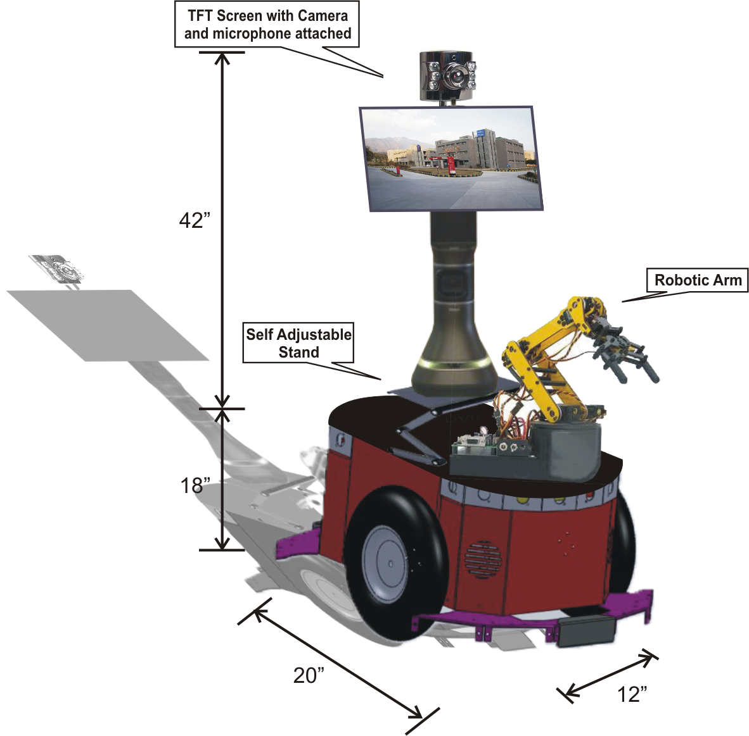
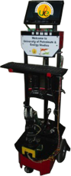
MODEL
Proposed Model(CAD)
Developed Model

Slide 5
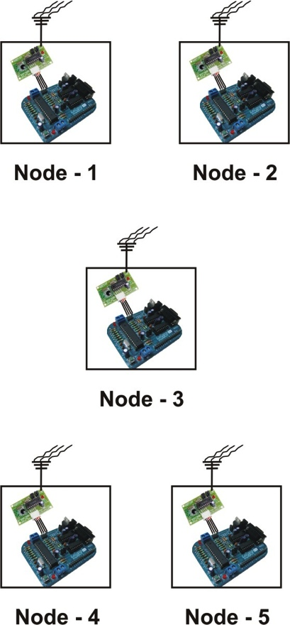
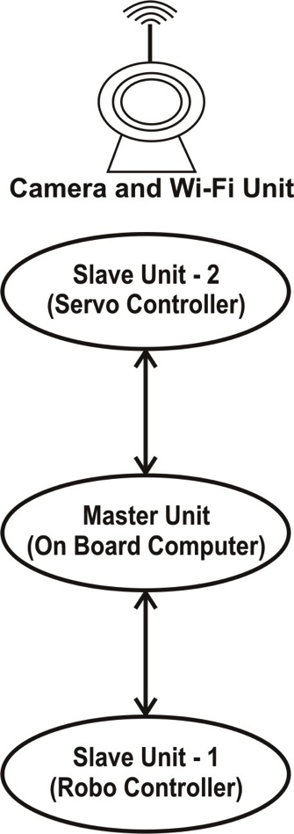
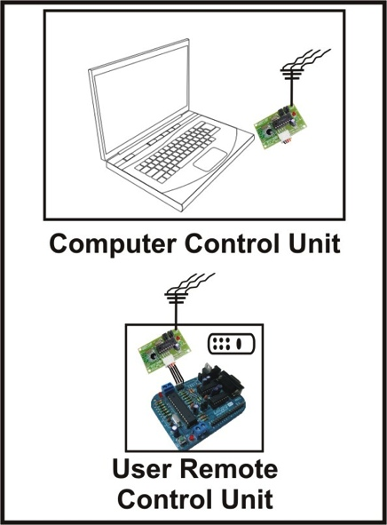
System Block Diagram

Slide 6
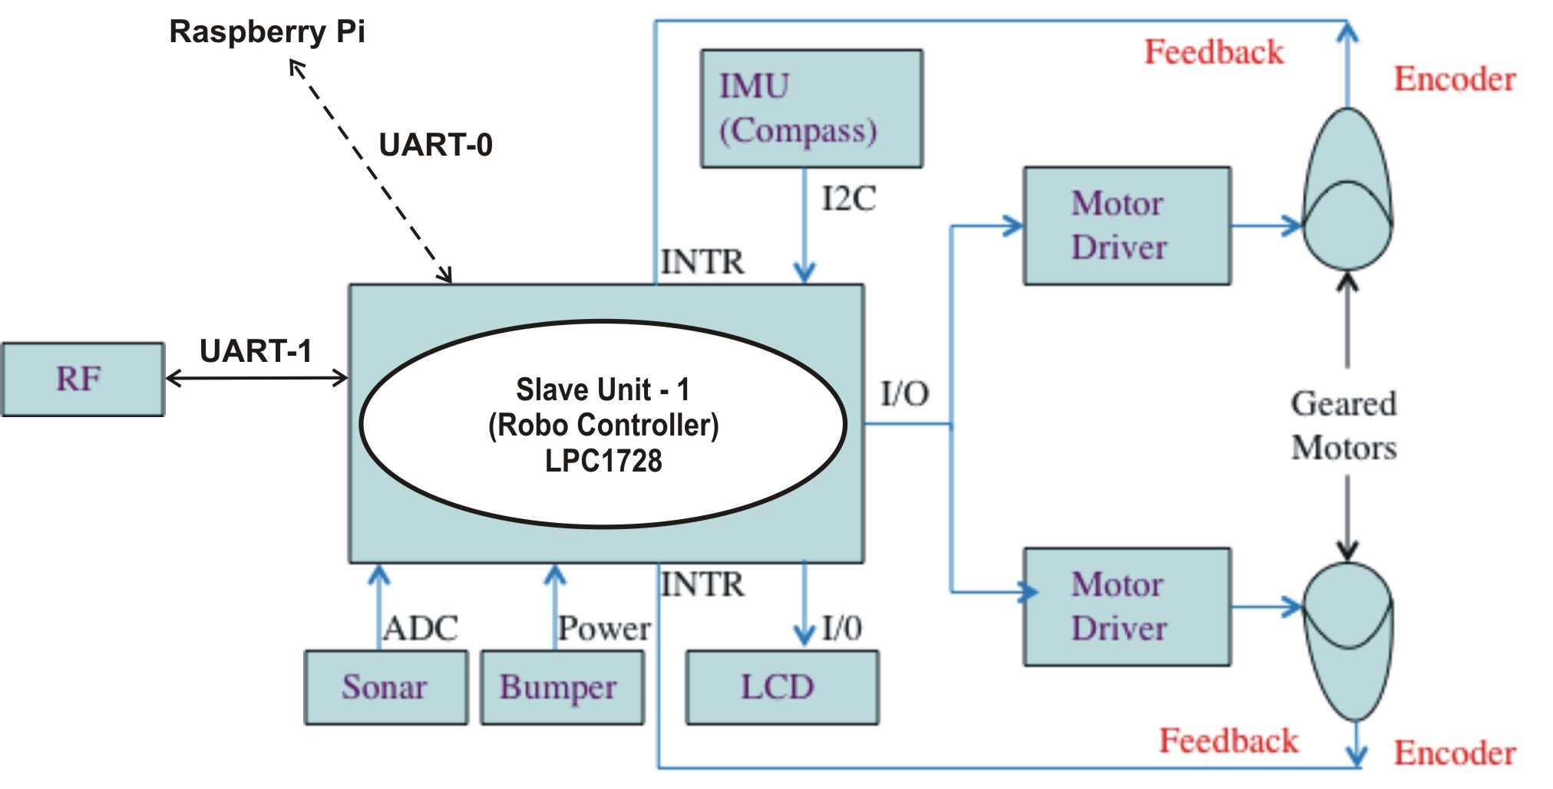
Slave Unit-1 Block Diagram

Slide 7
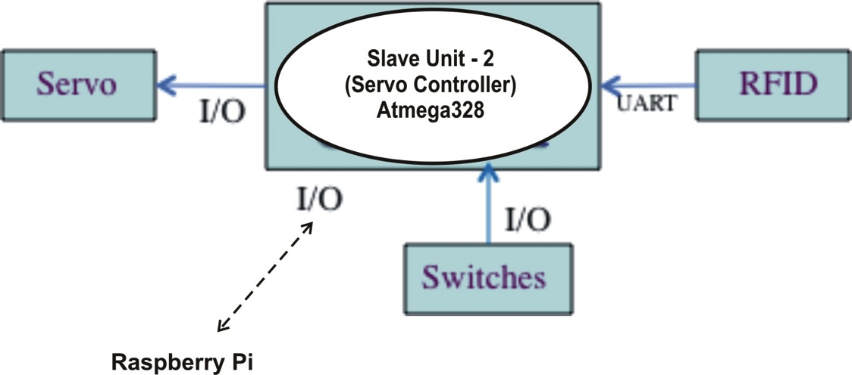
Slave Unit- 2 Block Diagram

Slide 8
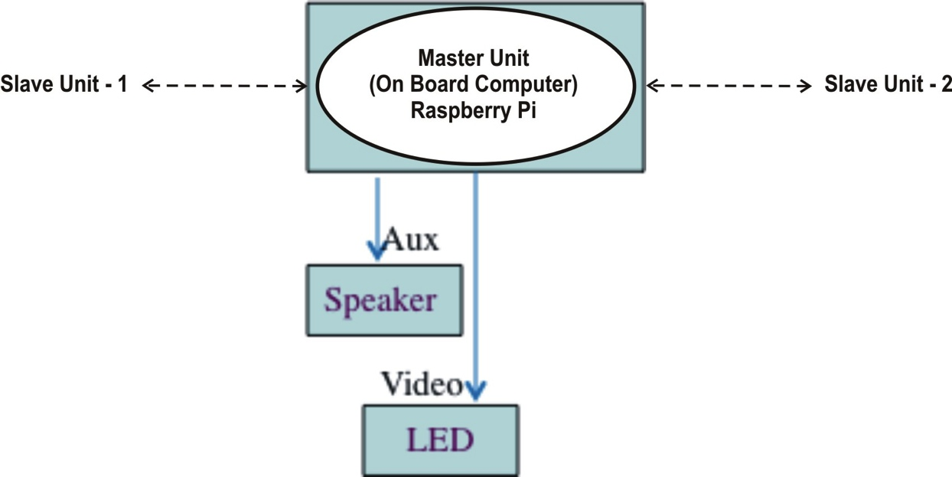
Raspberry Pi Block Diagram

Slide 9
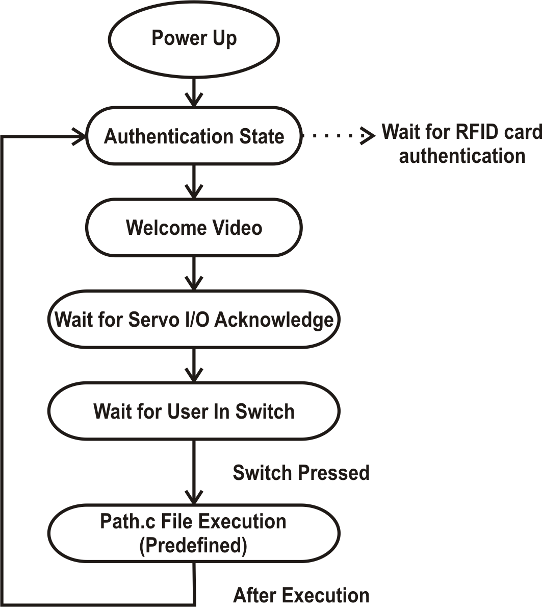
State Machine Diagram

Slide 10
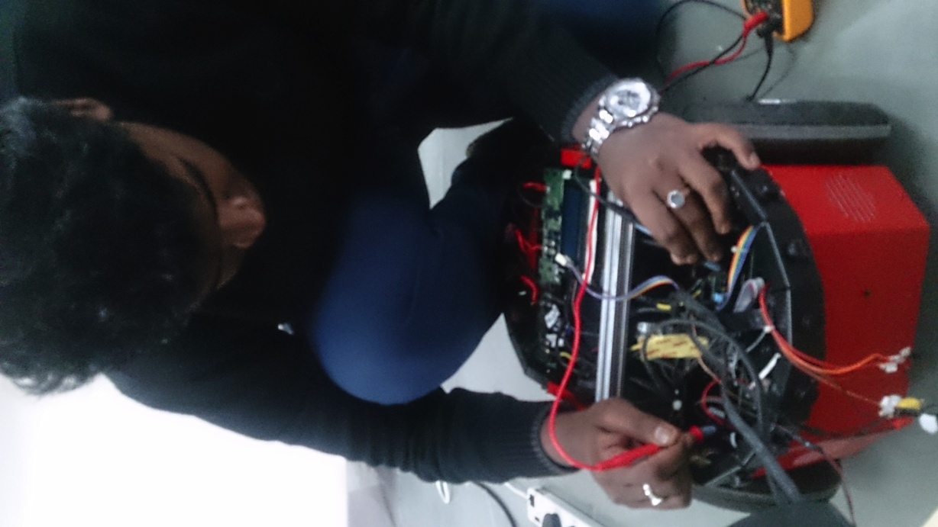
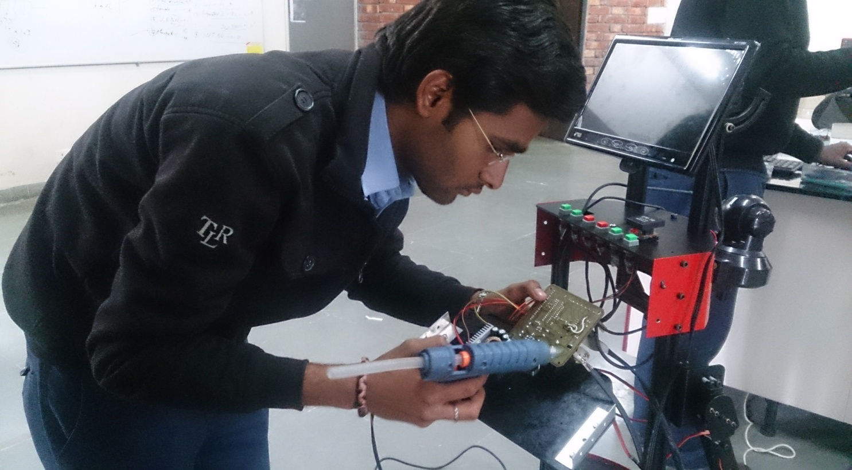
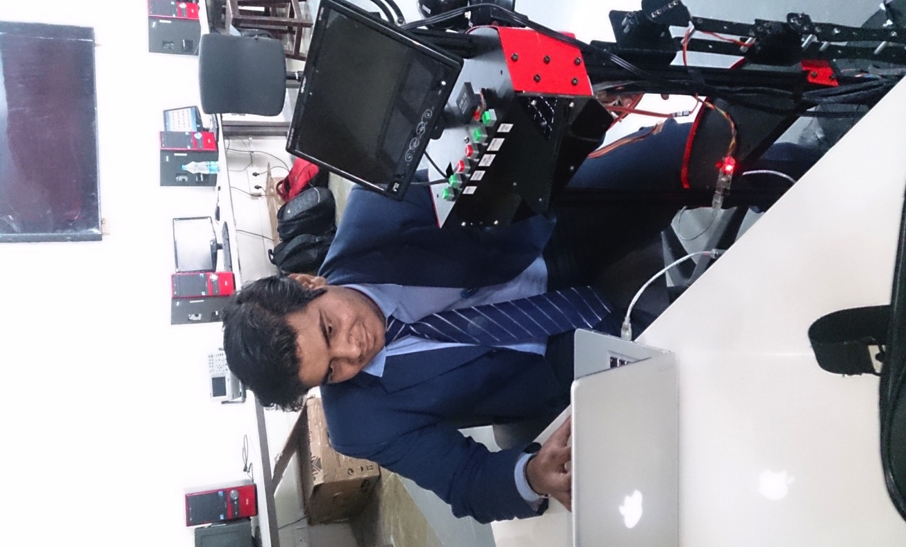
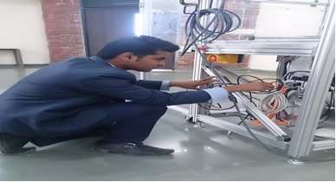
Students : Skill Set
Ishan Upadhyay
(Mechanical Structure and CAD)
Akash Srivastava
(Hardware design)
Jatin Kumar Khilrani
Shantmanu
(Team Leader and Firmware Developer)
(System Evaluator and P.R. Leader)

Slide 11
Mechanical Structure and CAD
By
Ishan Upadhyay

Slide 12
Specification of robot
Required acceleration – 1m/(sec)2
Mass of bot – 30 kg
Wheel diameter – 200mm.
No. of wheels - 2
Gear ratio - 51
Motor rpm – 149 rotation/sec
Max needed velocity – 0.5m/sec
Force (ma) – 30N
Force per wheel – 15N
Torque (FD) – 1.5Nm or 15 kg cm
Motor torque = torque/gear ratio – 0.2941176 Kg-cm
Power= force per wheel*max required velocity – 7.5 Watts per wheel
Wheel perimeter - 0.628318 m
Max gear ratio – 57.2950

Slide 13
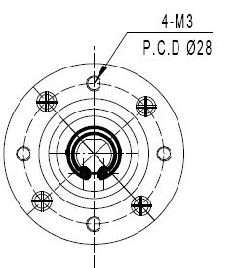
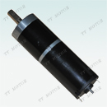
Motor Specification
Model: GMP36-36621276-51
Gear Ratio: 1/51
VOLTAGE |  | NO LOAD |  | AT LOAD |  |  |  |  | STALL
OPERATING RANGE V | NOMINAL | SPEED | CURRENT | SPEED | CURRENT | TORQUE |  | OUTPUT | TORQUE |  | CURRENT
 | V | rpm | A | rpm | A | N.m | Kg.cm | w | N.m | Kg.cm | A
9-15 | 12.0 | 149 | 0.5 | 120 | 1.9 | 0.5 | 5.1 | 6.3 | 2.3 | 24 | 5.10

Slide 14
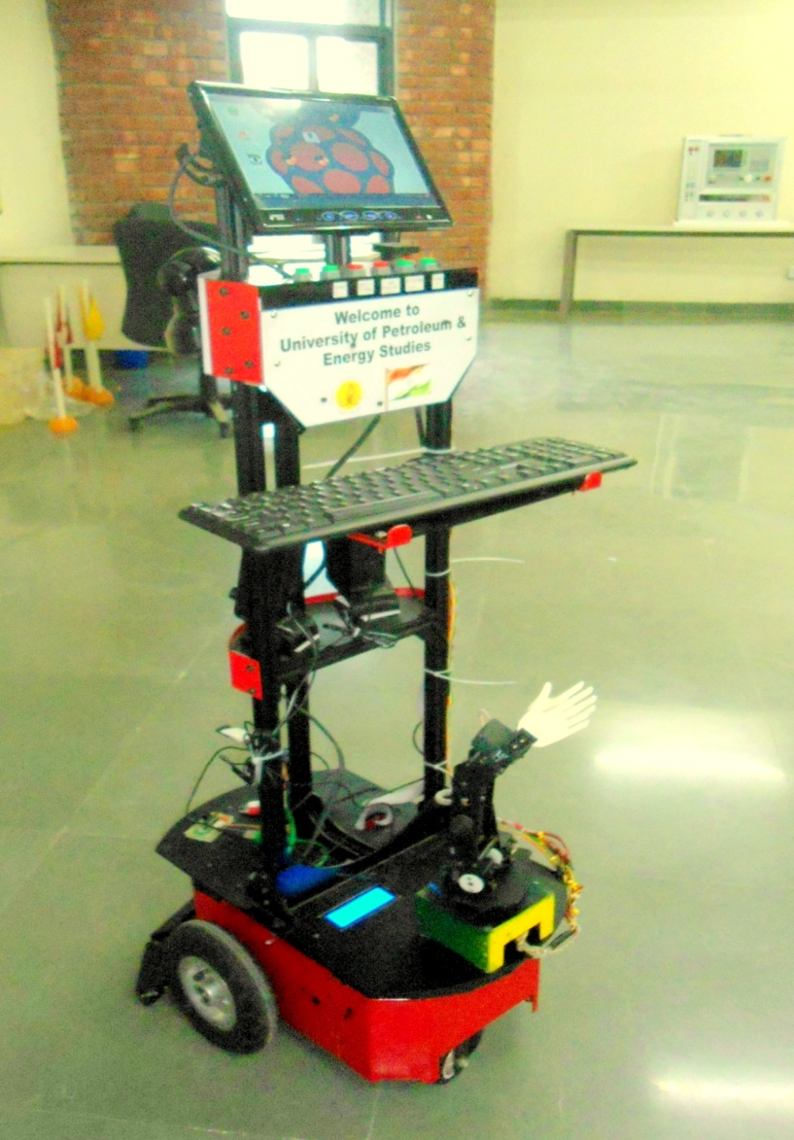
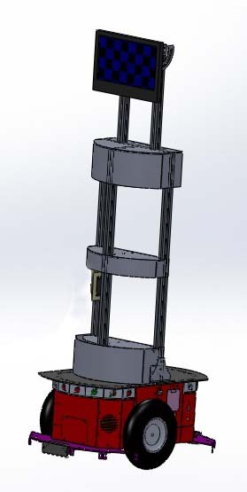
CAD model
Cad Model design
Developed Model
300mm
800mm
1025mm
225mm
264mm
380mm

Slide 15
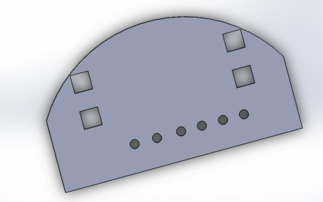
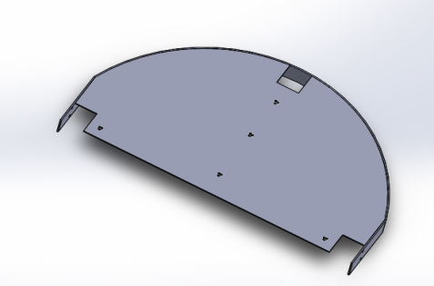
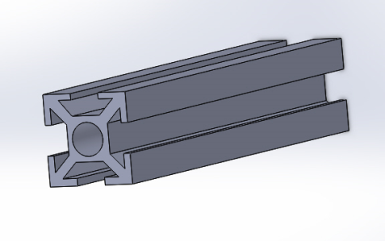
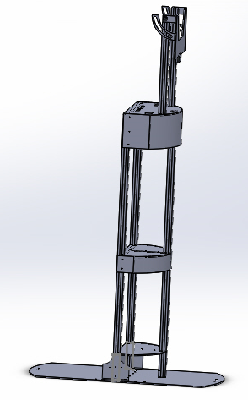
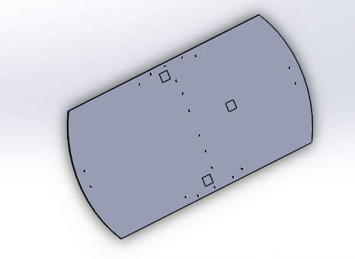
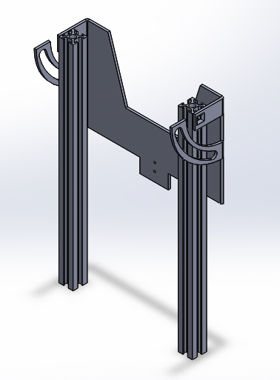
Different CAD design
Upper cover
Mid cover
Stand rod
Base cover
LCD Stand
Final design

Slide 16
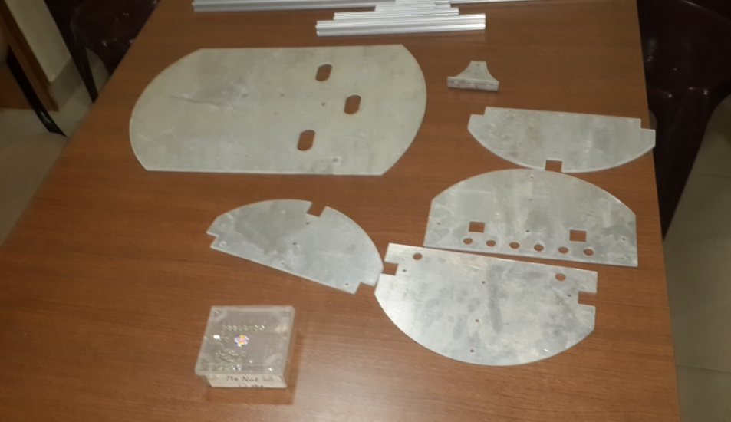
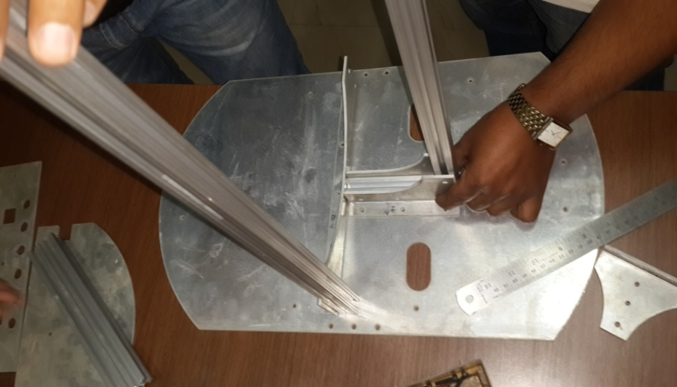
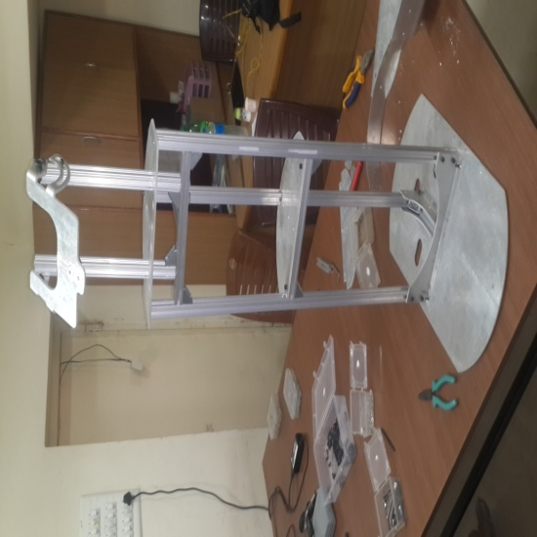
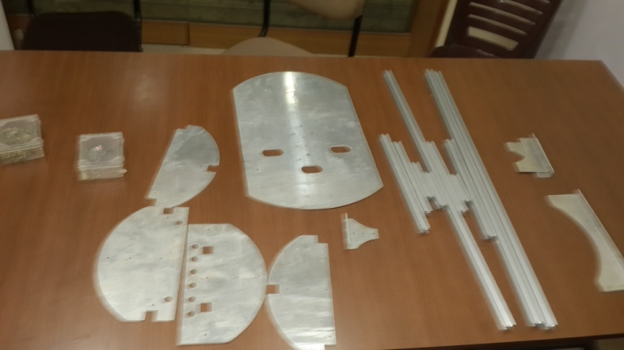
MECHANICAL STRUCTURE PROCESS
Sheet cutting as per the
proposed system.
Assembling as per the
proposed system.

Slide 17
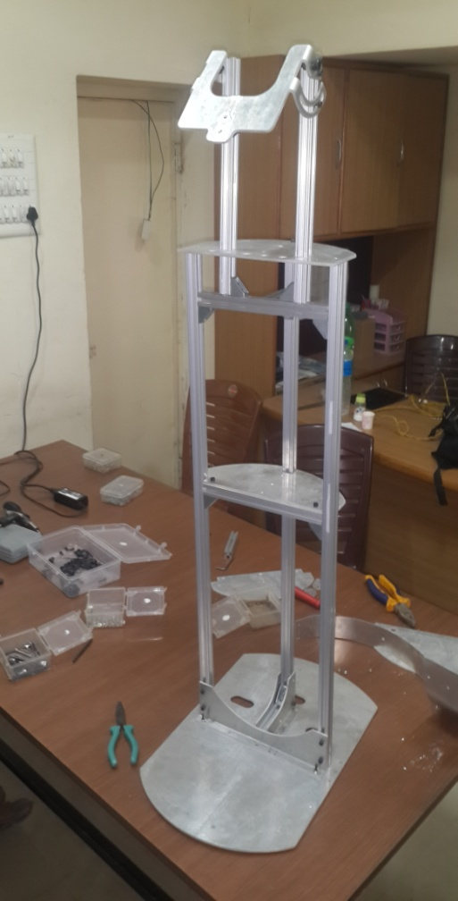
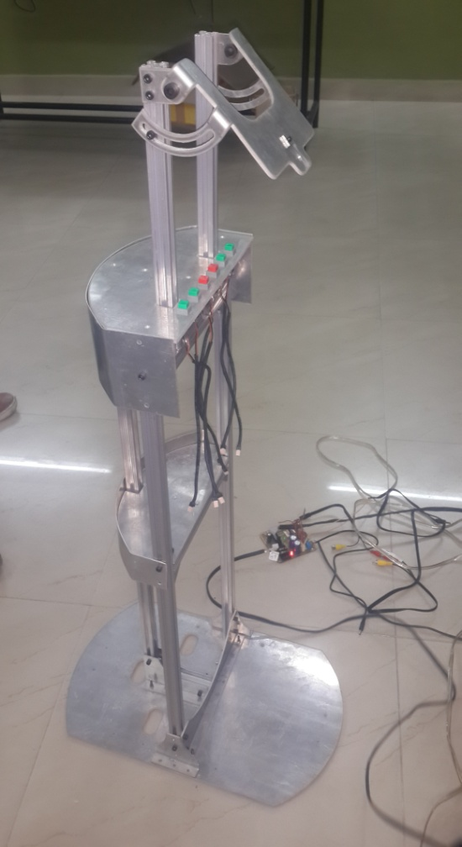
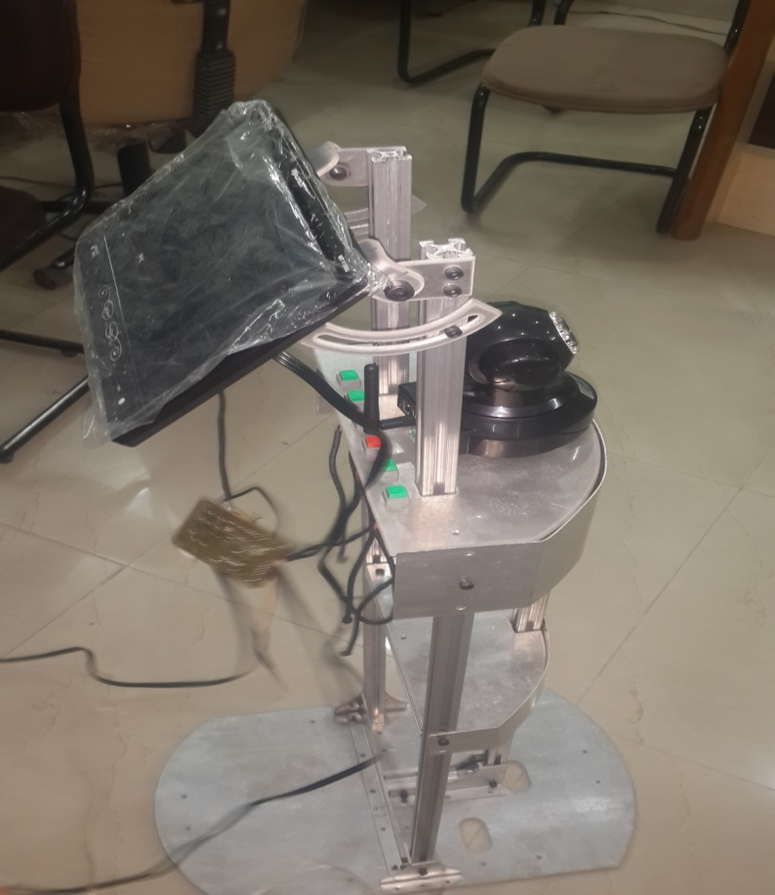
Assembled part.

Slide 18

Hardware Design & Interfacing
by
Akash Srivastava

Slide 19
Index
Components to be discussed are as follows:-
Raspberry Pi(Master Control Unit)
Arm Processor(Slave Unit 1)
Atmega 328(Slave Unit 2)
Sonar Sensor
IMU
RFID Reader
Motor Driver
RF Module
Other components

Slide 20
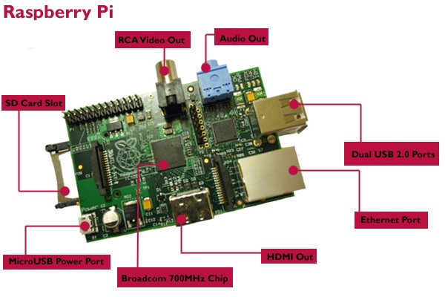
Raspberry Pi
Raspberry Pi is our main master control unit of the Robot “Pratham”.
Specifications:-
Operating system-Linux
Memory- 512MB SDRAM
CPU- 700 MHz Low Power ARM1176JZ-F
Video Output- HDMI ,Composite RCA
Dimensions- 8.6cm x 5.4cm x 1.7cm
Onboard Storage- SD, MMC, SDIO card slot
Ethernet- onboard 10/100 Ethernet RJ45 jack
RCA Video Out
Audio Out
SD Card Slot
Dual USB 2.0 Port
Ethernet Port
HDMI Out
Micro USB Power Port
Broadcom 700Mhz Chip

Slide 21
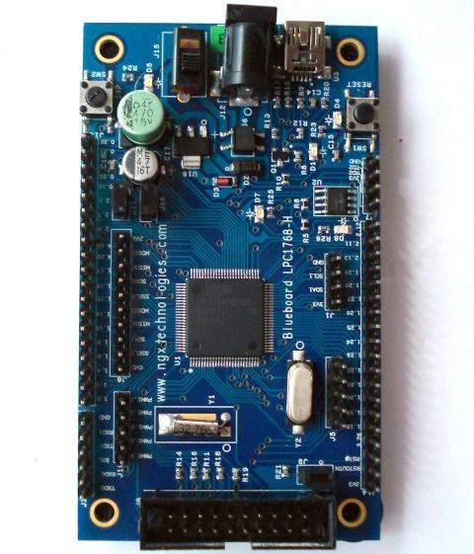
Slave 1(ARM Processor)
Specifications:-
Dimensions: 94.08x54.48 mm2
•Two layer PCB (FR-4 material)
•Power: USB powered or can be powered through the DC jack, 5-7.5V input
•Reset switch
•Work at 100Mhz Frequency
•32Khz crystal for RTC
•On board 258kb I2C EERPOM
•Extension headers for all microcontroller pins
•USB B-type connector for powering the board
•20pin - JTAG connector
Power Supply
Reset switch
ARM Processor
Interfacing Of Pi With Arm Processor
GPIO Pins

Slide 22
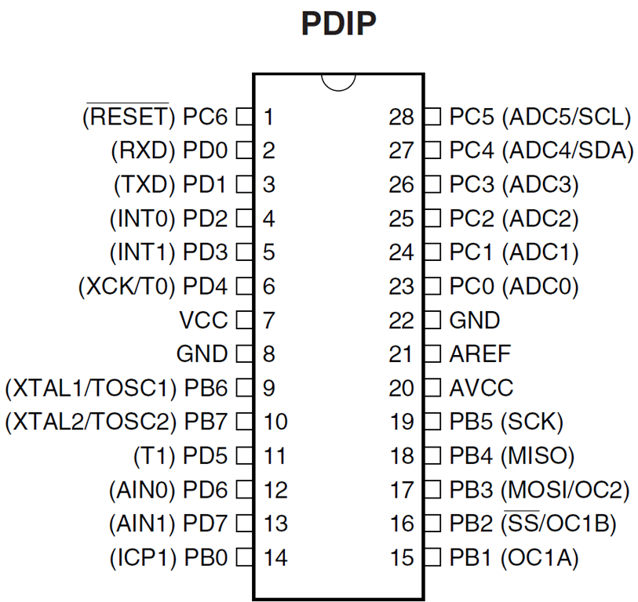
Slave 2(Atmega 328 )
Specifications:-
Six PWM Channels
6-channel 10-bit ADC in PDIP Package
Programmable Serial USART
32 x 8 General Purpose Working Registers
Operating Voltage:– 1.8 - 5.5V
Two 8-bit Timer/Counters
– One 16-bit Timer/Counters
Atmega 328

Slide 23
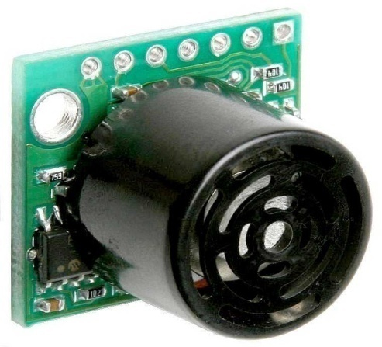
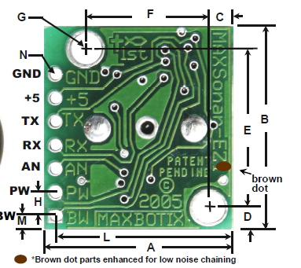
Sonar Sensor(EZ1)
It can detect objects from 0 inches out to 254 inches with 1 inch resolution.
The interface output formats includes :-
Pulse width output
Analog voltage output
Serial digital output
Specifications:-
2.5v-5.5v supply with 2mA Current draw.
Readings can occur up to every 50mS (20-Hz rate).
Objects detection includes zero range objects.
Serial,0 to Vcc,9600Baud.
Analog ,( Vcc /512)/inch.
Pulse width,(147uS/inch).
Sensor operates at 42KHz.
Here we used Bumper, if robot get out of control
and strike to some obstracle then it automatically get switch off.
Interfacinag of Sonar With Arm Processor

Slide 24
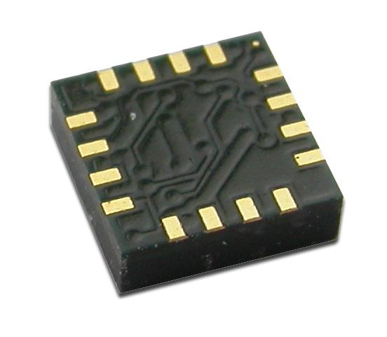
IMU(Inertial measurement unit)
This IMU basically consist of 3 devices i.e. Accelerometer ,Gyroscope & compass. For construction of robot ,we use only compass from this IMU.
For future Scope we will use accelerometer and gyroscope for movement of robot in incline plane.
It’s applications are for low cost compassing and
magnetrometry.
Specification:-
12-bit ADC that enables 1° to 2° compass heading accuracy.
Low voltage Operations(1.6 to 3.3v).
I2C Digital Interface.
Fast 116 Hz Maximum Output Rate.
HMC5883
Interfacing of compass with Arm Processor

Slide 25
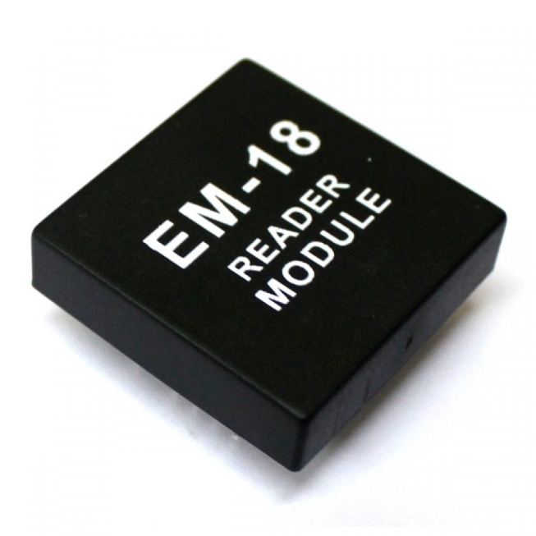
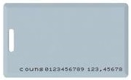
RFID module
EM-18 RFID Reader
Specifications:-
RF Transmit Frequency- 125kHz
Power Supply- 4.6V - 5.5VDC ± 10% regulated
Current Consumption- 50 mA < 10mA at power down mode.
Reading distance - Up to 100mm, depending on tag
Communications Protocol - Specific ASCII
Antenna - Integrated
Interfacing RFID reader with Atmega328

Slide 26

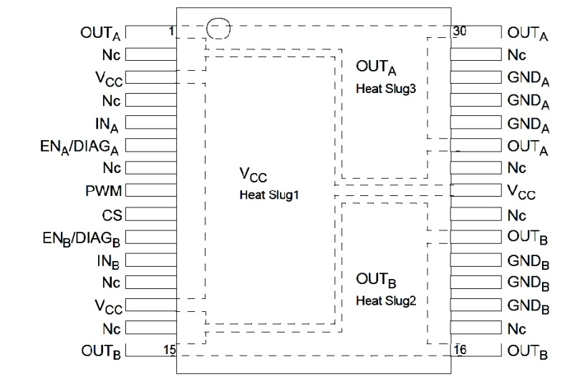
Motor Driver
The VNH3ASP30-E is a full-bridge motor driver.
It intended for a wide range of automotive applications.
Specifications:-
5V logic level compatible inputs.
PWM operation up to 20 kHz.
Iout=30A,Vout=41v.
Cross-conduction protection.
Under voltage and overvoltage shutdown
Very low standby power consumption
Thermal shut down
MultiPowerSO-30™
Interfacing Of Motor Driver with Arm Processor

Slide 27
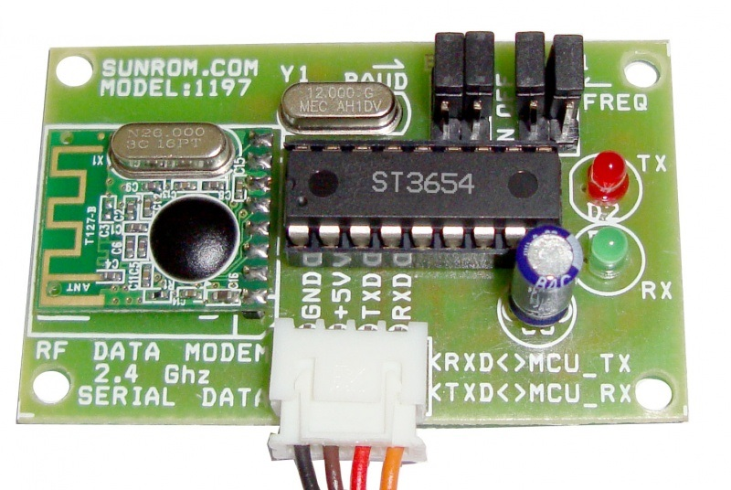
RF Module
RF data modem working at 2.4 Ghz frequency in half duplex mode.
Features :-
Working Voltage-min.-4.5v,max.-9v.
Range- 30 mtr.
UART baud rate (8 bit data, no parity, 1 stop bit) - 9600/4800/38400/19200 bps.
Automatic switching between TX and RX mode.
2.4 GHz band, no need to apply frequency usage license.
Protocol translation is self controlled, easy to use.
High sensitivity, reliable transmission range.
Standard UART interface, TTL(3-5V) logic level.
Error checking(CRC) of data in built.
Interfacing Of Rf module with Arm Processor and Atmega8

Slide 28
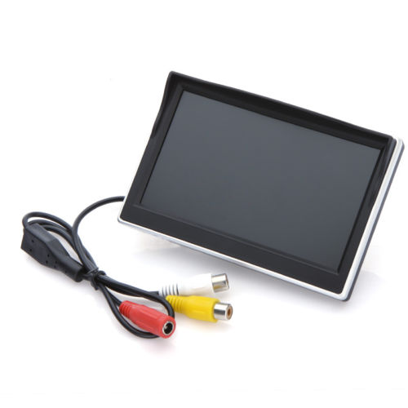
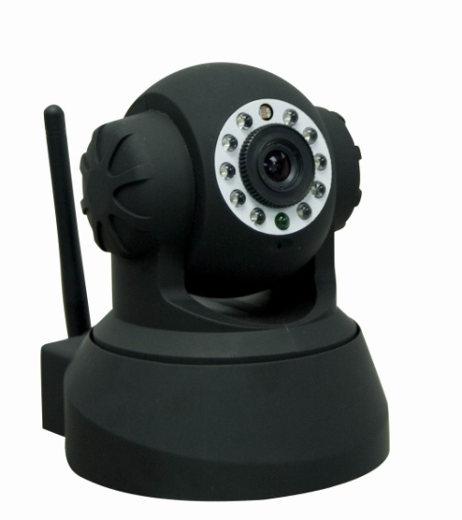

Electronics Components
TFT Screen
Screen size: 7 inch TFT 16:9 screen
Display component: Color TFT LCD display
Resolution: 480W * RGB * 272H
Power supply: DC 12V
Rated power consumption: 3W (Max)
Lead battery
12v,7Ah
IP Camera
Web Protocol
Lan Port
Wi-Fi 802.11
Power DC 5v

Slide 29
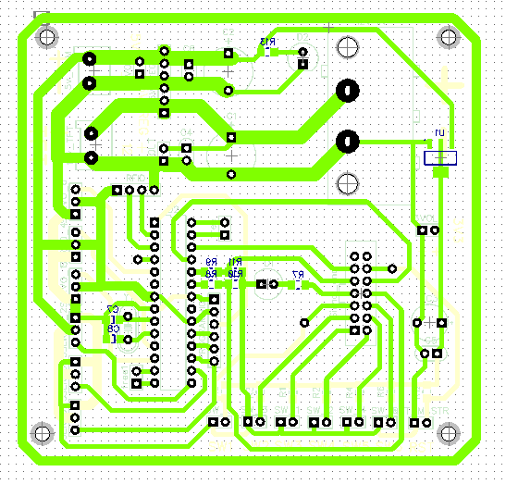
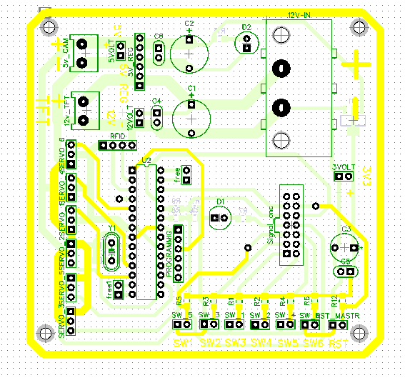
PCB Layout of Atmega 328

Slide 30
Power budget
S. NO. | Components | Voltage/Current
1. | ARM Processor | 3.3V / 2A
2. | Atmega-8 | 5V / 50-100mA
3. | Atmega-328 | 5V / 50-100mA
4. | Motor Driver | 12V &5V
5. | Raspberry Pi | 5V / 1A
6. | Encoder | 5V
7. | Sonar Sensor | 3.3V
8. | Compass Sensor | 3.3V
9. | Bumper Sensor | 3.3V
10. | 20*4 LCD | 3.3V
11. | TFT LCD | 12V
12. | Camera | 5V
13. | RFID Reader | 5V
14. | Servo Motor | 5V

Slide 31
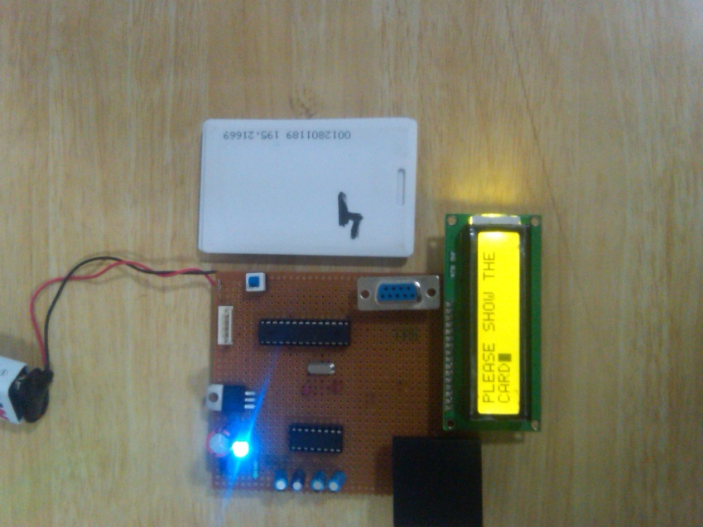
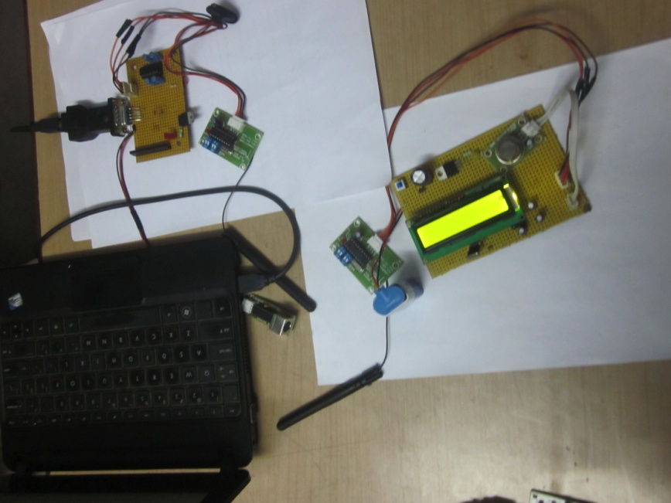
RFID and Zigbee Data Evaluation

Slide 32
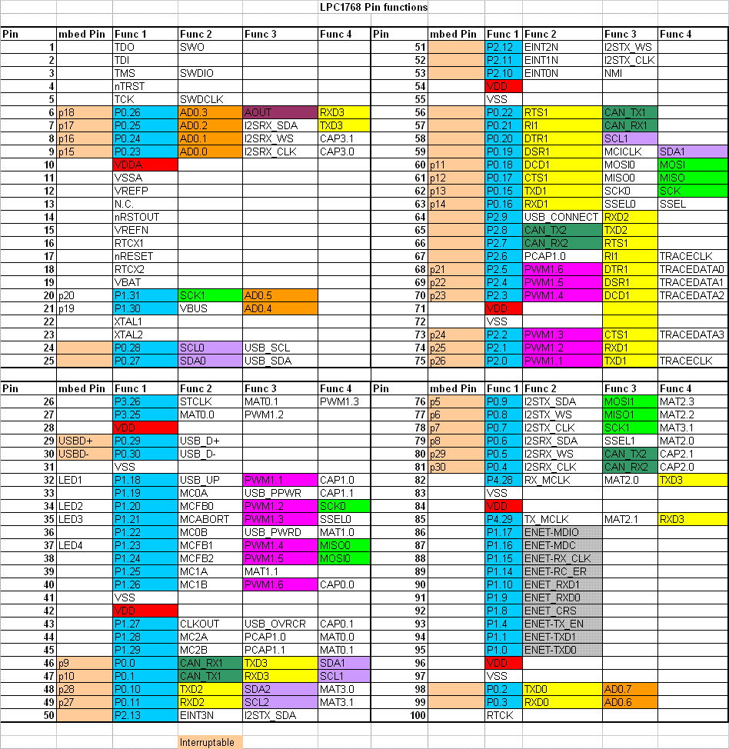
GPIO of ARM Processor

Slide 33
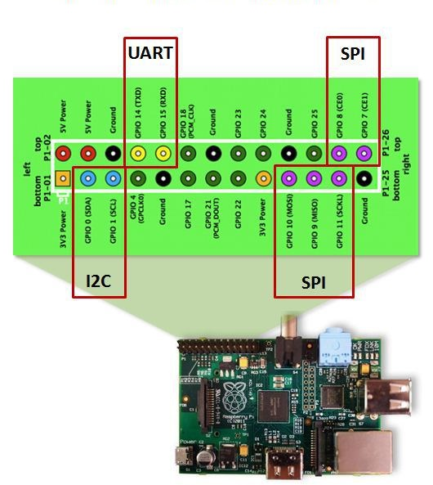
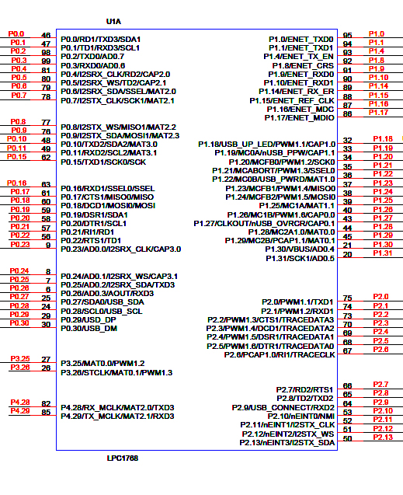
Interfacing of Raspberry Pie With ARM Processor
GPIO Pins

Slide 34
Hardware Interfacing of ARM with Sonar Array
Sonar 1
SEL 1.0
SEL 1.1
SEL 1.2
ADC_OUT 1
A 1.0
A1.1
A1.2
EN_MUX 1
SEL_EN1
Sonar 2
SEL 1.0
SEL 1.1
SEL 1.2
ADC_OUT 1
EN_MUX 1
A 1.0
A1.1
A1.2
SEL_EN2

Slide 35
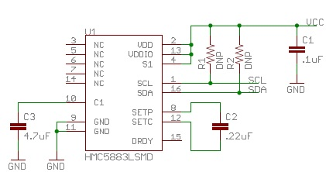
Hardware Interfacing of ARM & compass
Vcc
Compass Circuit
Gnd

Slide 36
PIN Configuration Of Compass IC(HMC5883)
PIN | NAME | DESCRIPTION
1 | SCL | Serial Clock –I2C Master/Slave Clock
2 | AVDD | Analog Supply
3 | NC
4 | NC
5 | NC
6 | NC
7 | NC
8 | SETP | Set/Reset Strap Positive-S/R Capacitor (C2) Connection
9 | GND | Supply Ground/Return
10 | C1 | Reservoir Capacitor (C1) Connection
11 | GND | Supply Ground/Return
12 | SETC | S/R Capacitor (C2) Connection
13 | DVDD | Digital Positive Supply
14 | VREN | Voltage Regulator Enable
15 | DRDY | Data Ready
16 | SDA | Serial Data –I2C Master/Slave Data

Slide 37
Interfacing of RFID Reader With Atmega 328
Atmega 328
RFID Reader
GND
VCC
TXD
RXD
UART

Slide 38

Pin Configuration Of Motor Driver

Slide 39
Hardware Interfacing of ARM ,Encoder & Motor driver
Left Motor driver
CS1
Encoder 1
PWM1
DIR1.1
Motor
out
DIR1.2
Signal 1
Right Motor driver
Encoder 2
CS2
PWM2
Motor
out
DIR2.1
INT 1
DIR2.2
Signal 2
INT 2

Slide 40

Interfacing of RF Module With ARM Processor
UART
Vcc
Gnd

Slide 41
Interfacing of RF Module With Atmega 8
UART

Slide 42
Firmware Development
By
Jatin Kumar Khilrani

Slide 43


Slide 44




Programming Phases
Raspberry pi 1st boot
Programming with atmega328
LCD status display via Arm controller
Wired Serial Interface

Slide 45

Programming Phases Cont…
Integrating all the code in a single platform

Slide 46
Serial Communication Packet
HDR | Length | Command | Sub Command | Data | Data Checksum | Footer
1 2 3 4 5 6 7
1- HDR(Header)- AA is the first byte.
2- Length- Length of data byte.
3- Command- Command to Execute example:- Move, Set_Speed, Get_node_ID, Set node ID.
4- Sub Command- Move Forward, Move Backward.
5- Data- input given by user.
6- Checksum- Command+Subcommand+Data
7- Footer- 55 Last Byte

Slide 47
Serial Communication Packet Cont…
Function | HDR | Length | Command | Sub Command | Data | Data Checksum | Footer
Robot Move Forward | AA | 02 | 07 | 01 | xx | 08+xx | 55
Robot Move Backward | AA | 02 | 07 | 02 | xx | 09+xx | 55
Robot_Rot_Clk | AA | 02 | 08 | 03 | xx | 0B+xx | 55
Robot Rotate_Anti_Clk | AA | 02 | 08 | 04 | xx | 0C+xx | 55
R0bot Set Speed | AA | 02 | 01 | 00 | xx | 01+xx | 55

Slide 48
Odometry*:- Heading Correction
The major challenge in our bot was to move the robot in a straight line.
Deviation in the angle by even 0.1 degree might change the path of the robot by wide margin.
Solution:-
We have used Odometry for calculating the position of wheeled robot.
Detailed solution:
Using Encoders :- For Accurately counting the rotation of robot wheels.
Mathematical Model:-
(1)- Distance = (left_encoder + right_encoder) / 2.0
(2)- theta = (left_encoder – right_encoder) / Wheel_Base;
For having a robot positon in 2-D Cartesian space as follows:
(1)- X_position = distance * sin(thetha);
(2)- Y_position = distance * cos(thetha);
*Referred IMU Odometry, by David Andersen

Slide 49
HeartBeat Mechanism
Synchronization among different controllers in a multicontroller environment
To generate proper handshaking signals between the master and slave controllers for proper communication.
While communicating Raspberry Pi with other controllers loss of one packet was observed.
Solution:
The acknodgement and status signal was sent to master controller by the slave controllers every 250msec.

Slide 50


Software Environment
Atmega328, Arm controller programming in AVR Studio 6.0
Easy Access to integrated tools
Software Extension through Atmel Gallery
Easy Debugging
Raspberry pi programming in GCC(terminal of linux)
Protected Mode
Networking with TCP/IP
Multiuser capability
Open Source

Slide 51

PID Motor Control
Proportional Integral Derivative
Is Used to control output from a combination of different factors.
Output = P*Θ + I*Θ + D*Θ’
P represents
Current error
I represents
Sum of past errors
D represents
-Rate of change of error

Slide 52
LCD Command Status
Current Heading:-Represents the current reading of the compass.
Target Heading:-Represents the target reading of the compass.
Slave Unit Command Status:-
CMFLT= command complete
FWD= Forward
RCL=Rotate Clockwise
RACL= Rotate Anticlockwise
STOP= Stoped
KILL = All process kill

Slide 53
Future Expansion
Sleep Mode
Dead Zone Defining
Interfacing with joystick
Testing under International Protection(IP) Environments
Working with accelerometer in break mode for slant.
Image Processing
Google Maps Integration
Filter Algorithm

Slide 54
Application Areas
Unmanned Building Surveillance
Robotic Research Platform
Prevention of Terror attacks
Perimeter Control

Slide 55
Block Diagram
Servo Controller
Servo
RFID
I/O
UART
I/O
I/O
Feedback
IMU (Compass)
Encoder
Switches
OBC
I2C
Motor Driver
INTR
Robo – Controller
(slave)
Aux
UART0
(RS232)
I/O
Geared Motors
Speaker
UART1
Video
RF
LED
INTR
Motor Driver
ADC
Power
I/0
Sonar
Bumper
LCD
Feedback
Encoder

Slide 56
System Evaluator And PR Leader By
Shantmanu

Slide 57
Evaluation Flow chart
Assembling and orientation
Rating and final Evaluation
Data reading and performance planning
Observation and Node Data collection
Calibrating the sensors and program plan
Configuring Robotic arm and LCD

Slide 58

Node Verification
Data collection form the following nodes and individual testing
1- Reception 2- Library
3- R & D Centre 4- Placement Block
5- MDC

Slide 59
Specifications of Delicate Tools
Observation of magnetic compass and Sensors
compass heading = 328.3° (depending on configuration)
pitch = 28.4°
roll = -12.4°
Bx = 55.11µT (x-component of magnetic field)
By = 12.33 µT (y-component of magnetic field)
Bz = -18.43 µT (z-component of magnetic field)

Slide 60
Current Flow
Stand Alone Wi-Fi camera : 0.2 A
Quadrature Encoder : 400mA
Pi + TFT and Keyboard : 750 mA
Wi-Fi camera : 1.3 A load
Increase in load operation (camera) : 750 mA
Motor running Condition : 2A
Total Current load : 6 A

Slide 61



Absolute Ratings
Parameter | Output Voltage (Vout)
Iout = 10mA VIN = 5 V | MINIMUM | TYPICAL | MAXIMUM
 | 3.267 V(req) 3.235 V(act.) | 3.300 V (req) 3.300 V (act.) | 3.333 V (req) 3.365 V (act.)
Typical Performance Characteristics
Drop out voltage
Short Circuit Current
Load Regulation

Slide 62


Interfacing with I²C
Data on SDA must be stable when SCLK is high.
Start and Stop conditions are exceptions
Before Rectification
After Rectification
Remarks:- clock line released and go HIGH
No difference between the device clocks and the state of the SCL line,
All the devices start counting their HIGH periods

Slide 63
Effect of K_{p ,}K_{I ,}K_{D} Parameters
 | K_{p} | K_{I} | K_{D}
Control Group | 2 | 0.0001 | 0.001
Step #1 | 1 | 0.0001 | 0.001
Step #2 | 2 | 0.001 | 0.001
Step #3 | 1 | 0.001 | 0.001
Step #4 | 2 | 0.01 | 0.001
Step #5 | 2 | 0.0001 | 0.01
Step #6 | 2 | 0.0001 | 0.1
Conclusion: Setting the values of K_{p ,}K_{I ,}K_{D} in step 6 lead to proper effects in system response

Slide 64
Final Trial and Error Rectification
Attempt 1
Heading (in degree) | Distance(in inches) | Nodes
320 | 100 | Node 1 (Reception)
230 | 20
160 | 48 | Node 2 (Library)
80 | 98
300 | 45 | Node 3 (R&D)
200 | 50
38 | 38 | Node 4 (Placement Block)
Remarks: Distortion of 29 degree in node2
Result: Attempt 1 distorted

Slide 65
Attempt 2
Heading (in degree) | Distance(in inches) | Nodes
300 | 100 | Node 1 (Reception)
200 | 20
180 | 48 | Node 2 (Library)
63 | 98
321 | 45 | Node 3 (R&D)
210 | 50
39 | 38 | Node 4 (Placement Block)
230 | 90
23 | 48 | Back to node 1 (Reception)
Remarks: Distortion of 29 degree in node2 was resolved.
Result: problem in fetching data from node 3

Slide 66
Attempt 3
Heading (in degree) | Distance(in inches) | Nodes
300 | 100 | Node 1 (Reception)
200 | 20
180 | 48 | Node 2 (Library)
63 | 98
321 | 45 | Node 3 (R&D)
210 | 50
39 | 38 | Node 4 (Placement Block)
230 | 90
23 | 48 | Back to node 1 (Reception)
Remarks: Supply to node 3 is provided through 5V adapter
Result: no error detected

Slide 67


Calibrating the Sensors
Fixing and communicating with AVR controls

Slide 68




Rectifying the Encoders
Communicating With LCD
Node Data collection
Configuring robotic arm and sensors

